Slide 1
Snehan Gorain
All About Me
Btt101 Sept 10

Slide 2
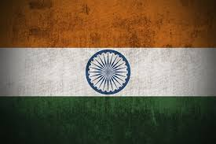
Background
Indian in origin
Born In Trail BC. Lived in the neighbouring town for 5 years.
Moved to Toronto Fall 2005

Slide 3
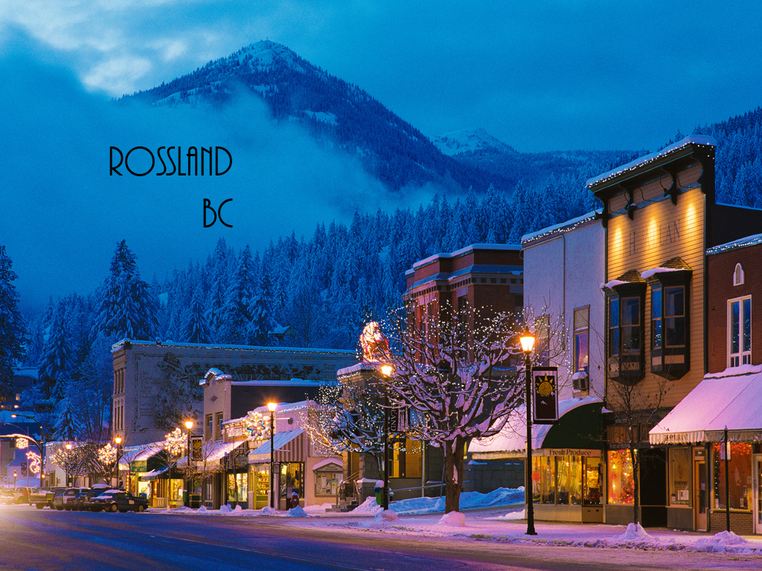
Rossland, the small Ski town where I lived till the age of five

Slide 4
Hobbies
Reading
Cooking
Trekking
Rollerblading

Slide 5
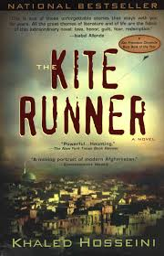
My Favourite book

Slide 6
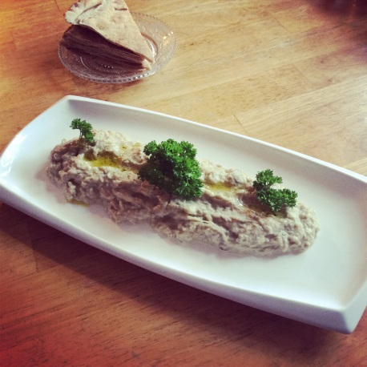
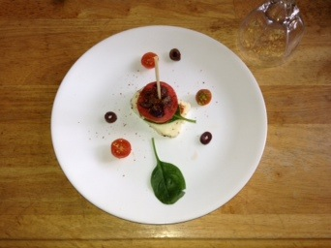
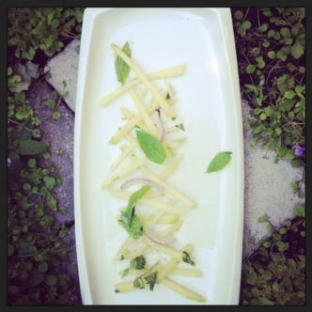
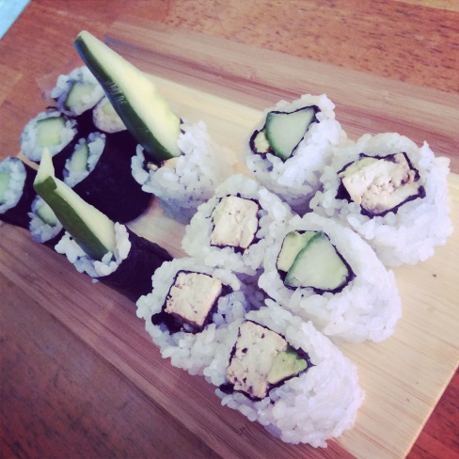
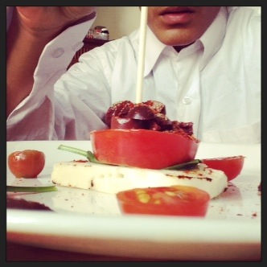
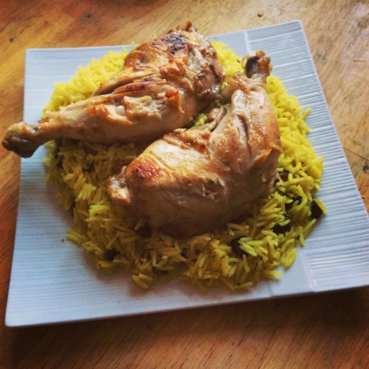
My Cooking Portfolio

Slide 7
My Past Schools
Mary McChormick for JK (British Columbia)
Alan Howard Waldorf School (Now called The
Waldorf Academy)
Homeschooled
Rawlinson Community School

Slide 8
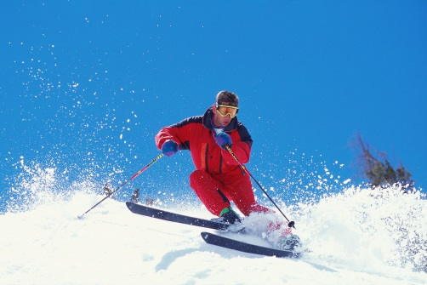

Sports I Enjoy
Ultimate
Skiing (cross country and downhill)
Trekking
Soccer

Slide 9
Music
I Listen to Music from the following countries:
Lebanon
Afghanistan (Farsi and Pashtu)
India (Bollywood and Punjabi)
Morocco
Algeria
Iran
Korea
Thailand
Japan
China (Cantonese and Mandarin)
France

Slide 10
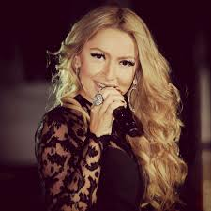
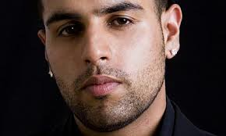
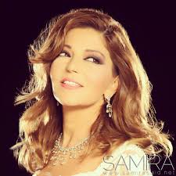
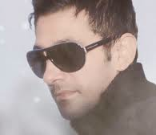
Some Artists I listen to
Jazz Dhami (Indian)
Hadise (Turkish)
Samira Said (Moroccan)
Shaan Khan (Afghan)

Slide 11
Goals for highschool
Open up as many opportunities (for the future) as possible by studying subjects that lead to more of them.
Do as well as I can in my subjects.
Choose the career path I want to go on after high school

Slide 12

My Future Job Possibilities
Chef
Entrepreuner
Criminal investigator

Slide 13
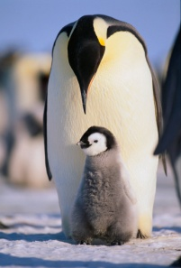
Places I want to Visit
Tabriz (Iran, fascinated with their culture)
Lapland (North Finland)
Kabul (Afghanistan, fascinated with their culture, and it sound like an adventure)
Antarctica (love the cold, ice and snow.
Therefore Antarctica is a place I have got to go).

Slide 14
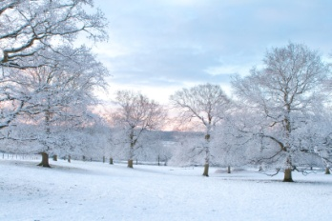
Other Random Information
I do not like summer, but I love winter
I love doing adventurous and daring things
My favourite colour is red
I speak Urdu and some French
I love learning and communicating in other languages

